Slide 1

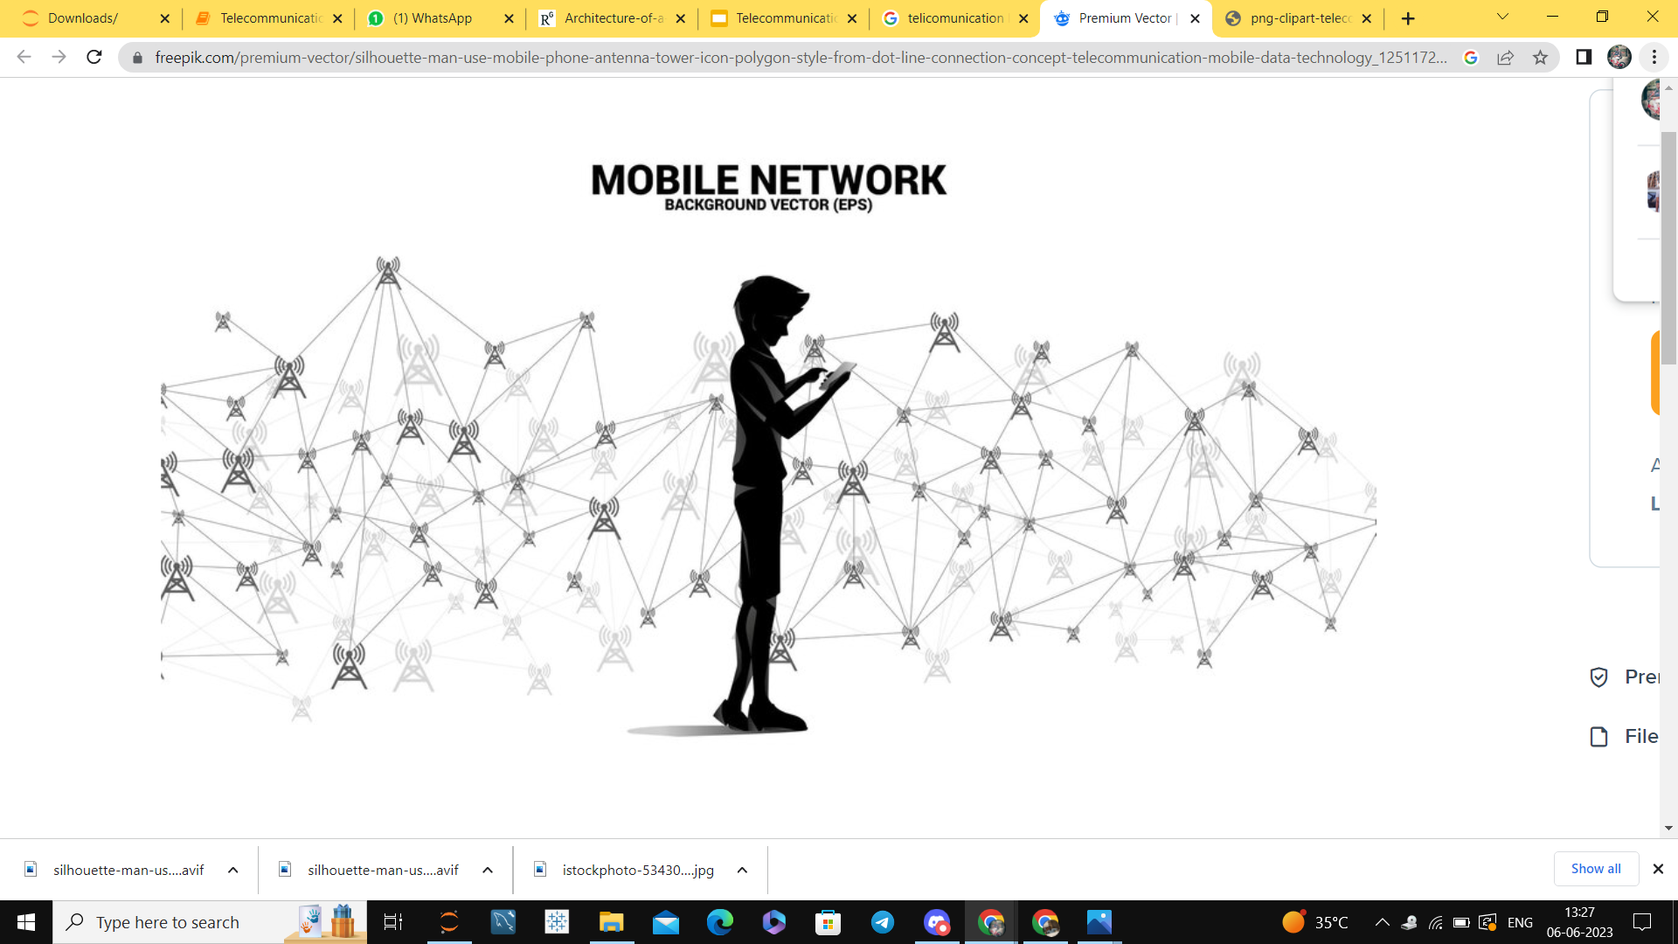
SEMANTIC SEARCH ENGINE IMPLEMENTATION
By
Ibteda Azeem
Degala Sravya

Slide 2
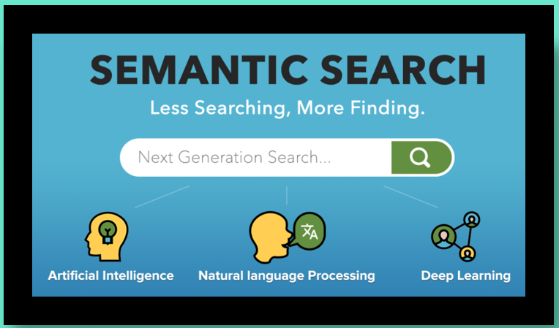
Problem Statement
Create an innovative search engine algorithm designed to swiftly locate subtitles according to user queries, prioritizing the content within the subtitles themselves.
Utilize advanced natural language processing and machine learning methodologies to optimize result accuracy and relevance.

Slide 3

Contents
Information Retrieval System
Applications of Information Retrieval System
Types Of Information Retrieval system
Steps involved in Projects
Data extraction
Data Preprocessing
Embeddings Generation
Storing embeddings and metadata
Retrieving the data

Slide 4
Information Retrieval System
Task of finding relevant information (documents/book/product) that satisfies the user’s Information need.
USER QUERY
INFORMATION RETRIEVAL SYSTEM
RELEVANT INFORMATION
CORPUS

Slide 5



Applications Of Information Retrieval System
Search Engine
E-Commerce Store
Online Book Store

Slide 6
Types Of Information Retrieval System
KEYWORD BASED
BOOLEAN RETRIEVAL
SEMANTIC RETRIEVAL
COLLABORATIVE FILTERING
These are the most common type, where users enter keywords or phrases into a search engine, and the system returns relevant documents based on those keywords
These systems allow users to combine keywords using Boolean operators (AND, OR, NOT) to refine their search queries. They retrieve documents that match the Boolean expression specified by the user.
These systems aim to understand the meaning behind the user's query and the content of documents. They may use natural language processing (NLP) techniques to analyze and interpret text semantically, allowing for more nuanced search results.
These systems recommend items (such as documents, products, or media) to users based on the preferences and behaviors of similar users. They analyze user interactions and feedback to generate personalized recommendations

Slide 7
Steps Involved In The Project
CHUNKING
DATA EXTRACTION FROM DATABASE
DATA SAMPLING
DATA PREPROCESSING
GENERATING
CONTEXTUAL EMBEDDINGS
SEMANTIC SEARCH
CHROMADB COLLECTION
STORING EMBEDDING AND METADATA IN CHROMADB VECTORSTORE
QUERY
RESULT

Slide 8
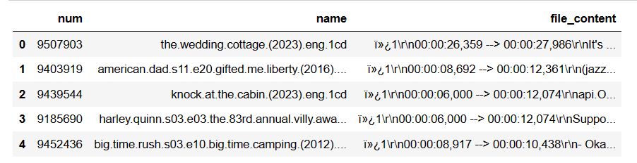
Data Extraction and Sampling
Extracting the data from the database.
Originally data consist of 82498 srt files
It consist of the number,name of the file and file content.
Taking 30 percent of data using random sampling because of computational constraint.
Now our data has 24749 files.
Decompressing the data

Slide 9
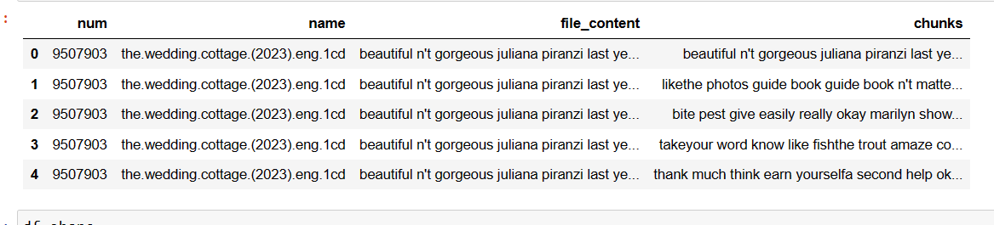
Data Preprocessing and Chunking
we require file content column for data preprocessing.
Removed special characters and digits .
Removed stopwords
Lemmatization
Created chunks with chunk size of 500 tokens and overlap of 20 tokens.
Finally we got 136536 rows after chunking.

Slide 10
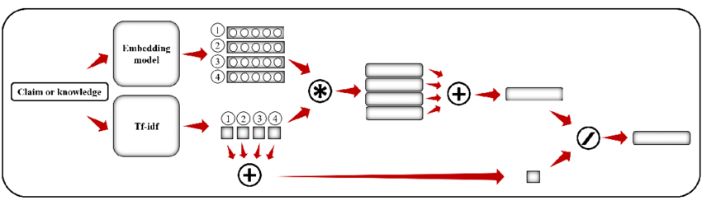
Embeddings for Document Representation
Bag-of-Words (BOW) / TF-IDF
Represents documents as vectors based on word counts and importance.
Suitable for keyword-based search engines.
Document Chunker
Divides large documents into manageable chunks (e.g., 500-token windows) with overlaps.
Ensures efficient embedding without losing context.
BERT-based Sentence Transformers
Utilizes pre-trained BERT models to encode semantic information.
Enables development of a semantic search engine capturing contextual meaning.
TF-IDF is having issue called higher dimensionality and no semantic meaning. So, preferred BERT based search engine due to less dimensions and semantic context.

Slide 11
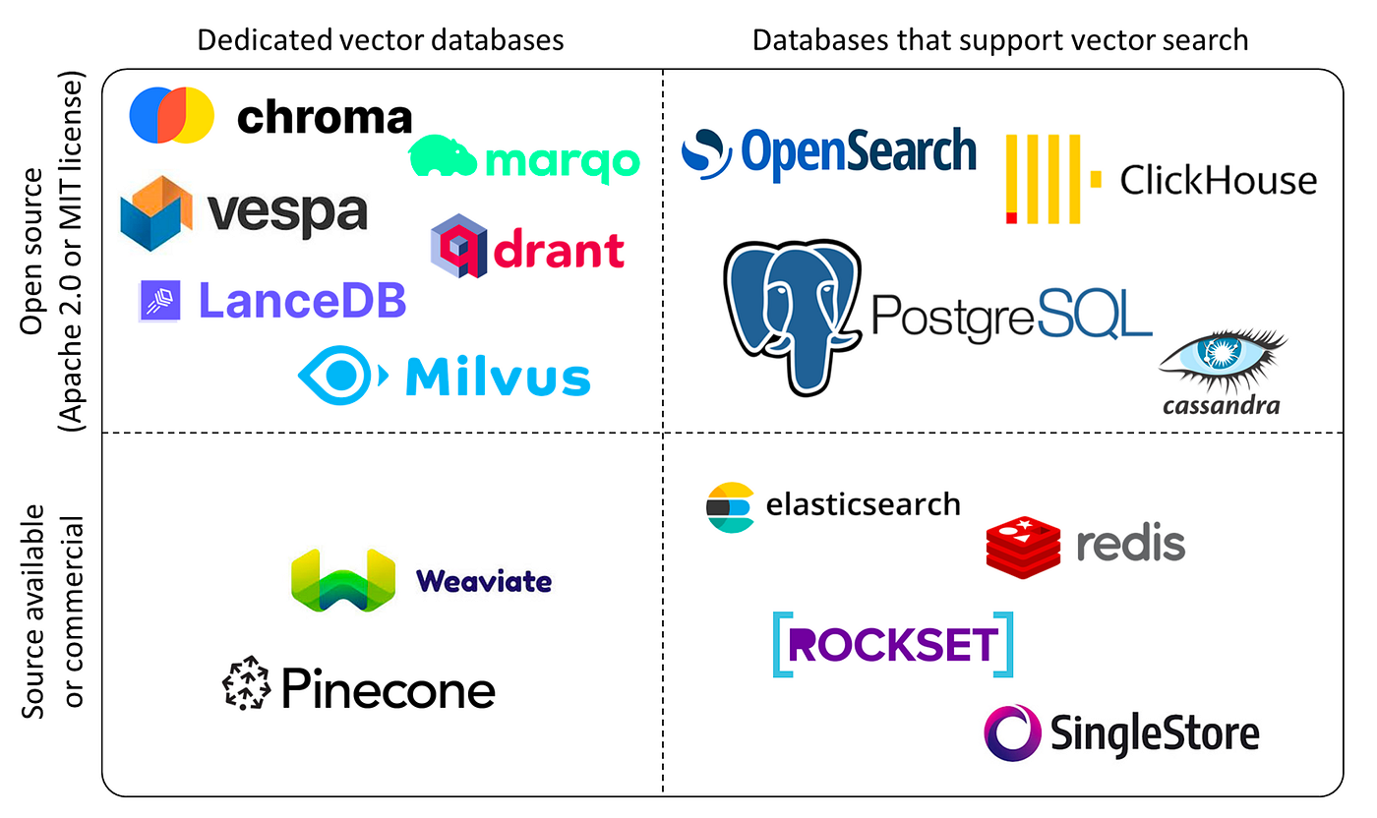
Introduction to Vector Databases
Vector databases are specialized databases designed to efficiently store and query high-dimensional vector data, often used in applications involving machine learning, natural language processing, and image analysis.
Types of Vector Databases:
Open Source Vector Databases: are freely available and typically developed collaboratively by the community.Examples: Chroma DB, Milvus, Annoy, Marqo, etc.
Commercial Vector Databases:are proprietary solutions offered by companies for enterprise use.Examples: Pinecone DB, ArangoDB, etc.
Use Cases of Vector Databases:
Search Engines:
Recommendation Systems:
Image and Video Analysis:
In our project we used open source Vector database: Chroma

Slide 12

Storing Embeddings into Chroma DB
Description:
Designed for storing and querying high-dimensional vector data efficiently.
Optimized for similarity search operations.
Key Features:
Supports nearest neighbor search based on cosine similarity.
Efficient indexing and retrieval of embeddings.
Use Case:
Ideal for search engines using advanced embeddings (e.g., BERT-based) to retrieve similar documents.

Slide 13
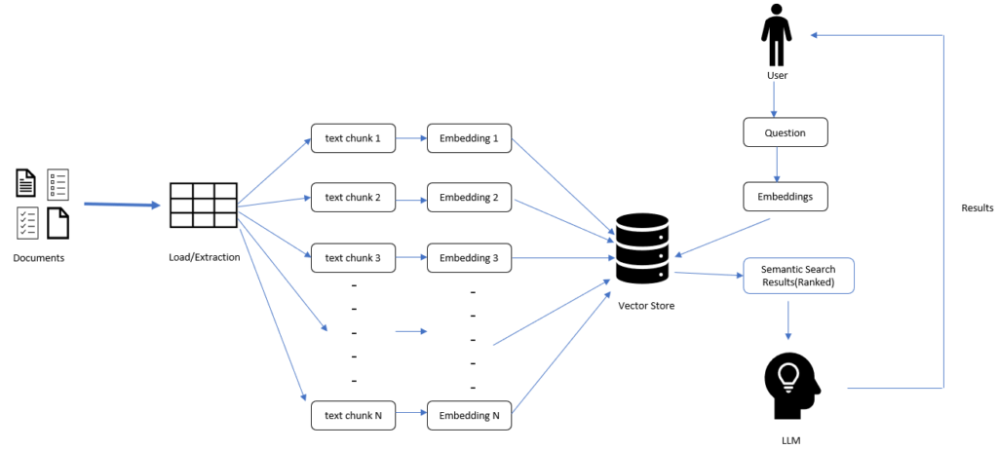
Retrieving Documents
Process Overview:
User Query Processing:
User's search query.
Preprocessing (if Required):
Tokenization: Splitting the query into individual words or tokens.
Cleaning: Removing stop words, punctuation, and other noise.
Normalization: Converting words to lowercase, handling synonyms, etc.
Query Embedding:
Embedding Technique: Utilize BERT-based SentenceTransformers or similar methods.
Purpose: Convert the processed query into a numerical vector representation capturing semantic meaning.
Cosine Similarity Calculation:
Definition: Cosine similarity measures the angle between two vectors.
Use: Calculate cosine similarity between the query embedding vector and document embedding vectors.
Ranking Documents:
Scoring Mechanism: Higher cosine similarity scores indicate greater relevance.
Result: Retrieve and rank documents based on similarity scores.

Slide 14




Streamlit User Interface

Slide 15


